Slide 1
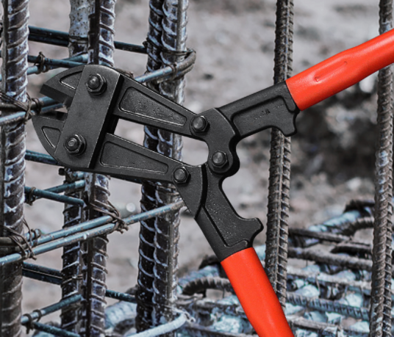


Foldable Bolt Cutter
Foldable bolt cutter
18” bolt cutter
Drop-forged alloy steel jaws for easy cutting hard & soft metals .
Ergonomic bi-material Anti-slip grips provide greater control and comfort in cutting
Ideal for cutting soft metal, bolts, rods, rivets and chain
Locking mechanism for compact storage and easy carrying
PATENTED

Slide 2
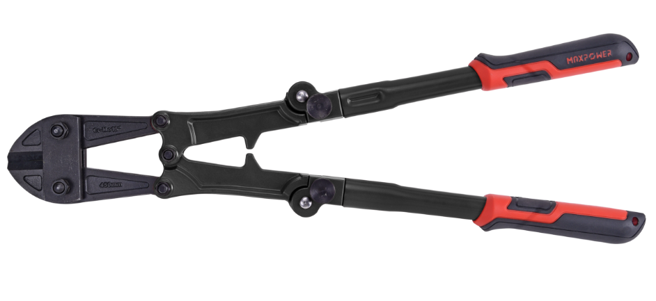
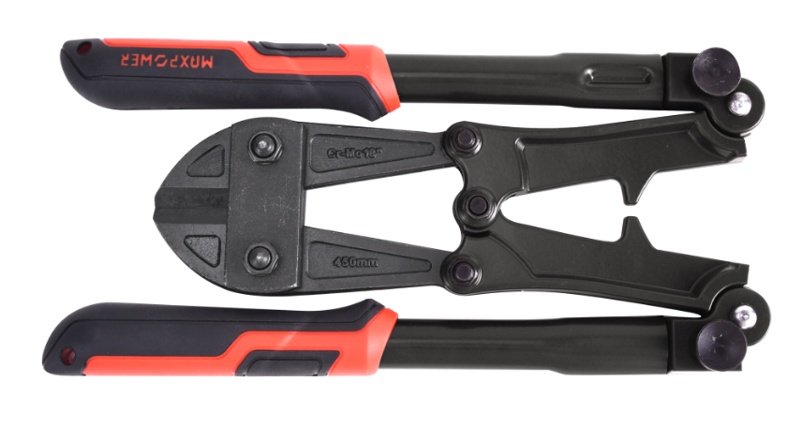
Foldable Bolt Cutter
ater pump pliers
Foldable bolt cutter
PATENTED
500mm
COMPACT SIZE TO FIT 12” TOOL BOX
280mm

Slide 3
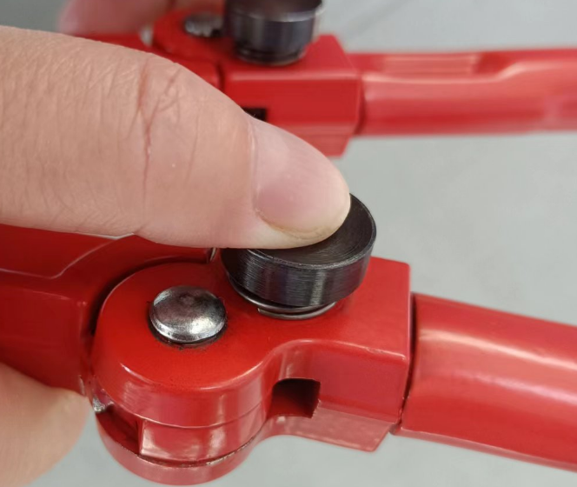
Foldable Bolt Cutter
Foldable bolt cutter
PATENTED
Quick release, the pipe can be easily folded when push the button

Slide 4
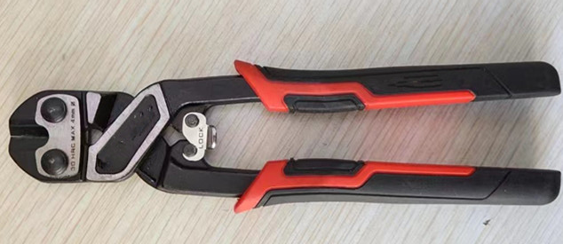
Mini Bolt Cutter
Foldable bolt cutter
8” Mini bolt cutter
Full body CRMO drop forged
Ergonomic bi-material Anti-slip grips provide greater control and comfort in cutting
Cuts the bolts, chains, threaded rods, wires and many other metals.
216mm

Slide 5
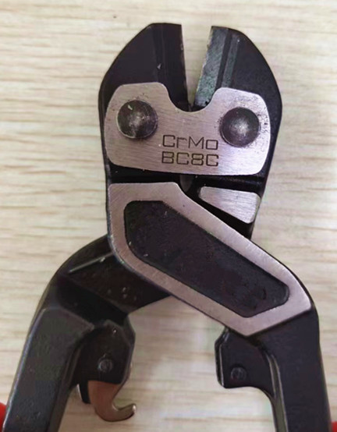
Mini Bolt Cutter
Foldable bolt cutter
High Frequence treatment cutting eadge
Logo position(forging, Lasering)
Security Lock

Slide 6
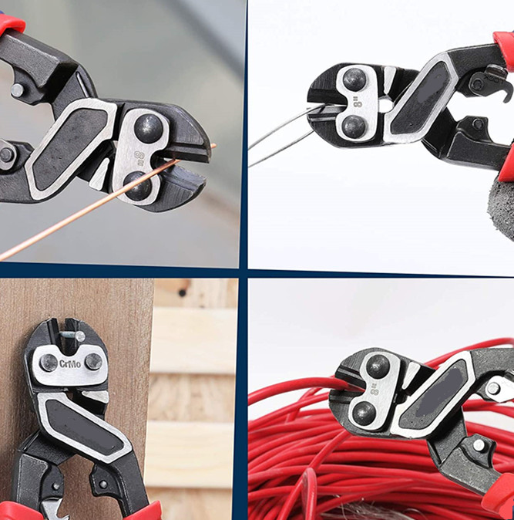
Mini Bolt Cutter
Foldable bolt cutter
Cuts the toughest bolts, chains, padlocks, threaded rods, wires and many other metals.
Cutting Capacity: Dia 4mm

Slide 7
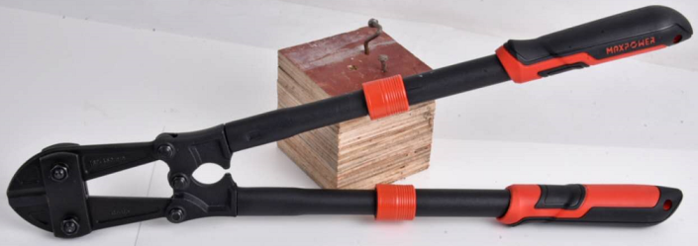
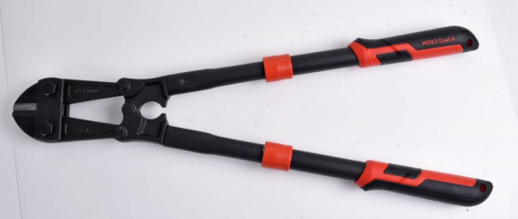
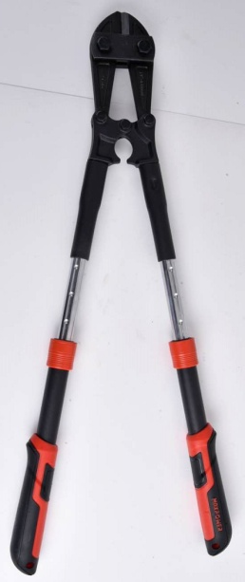
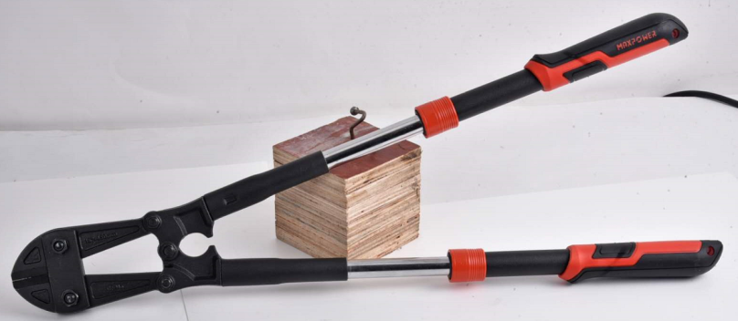
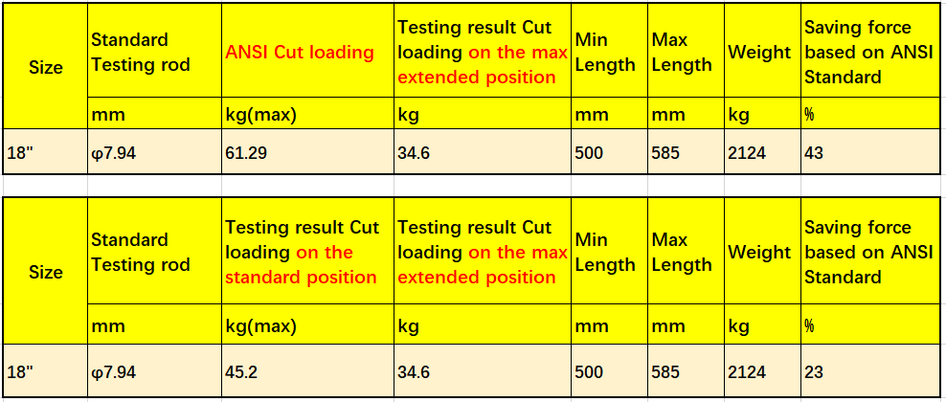
WD-40 Telescopic Labor Saving Bolt Cutter
BOLT CUTTER
With this button can stop at favorable places
Size: 14”18’’24”; Patented product Torque to meet ANSI standard
Body length: 500mm – 585mm
Telescopic handle can be located at 4 positions
Telescopic handle can save about 15-30% labor at the longest position.

Slide 8
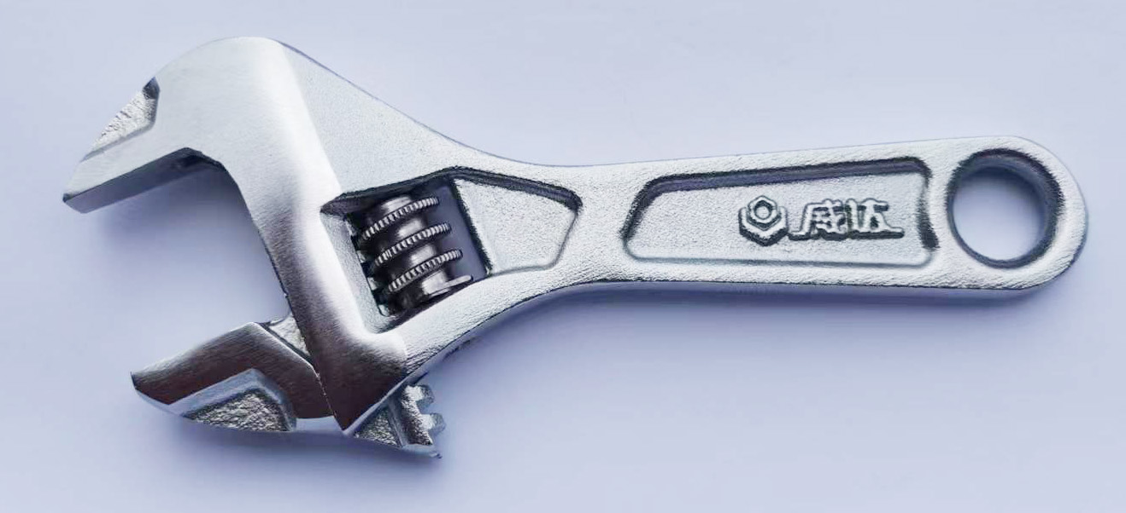
stuby adjustable wrench
WB-02DC型短柄活扳手
Size: 8’’ 10’’ 12’’
Open capacity 8” 24mm, 10” 29mm, 12” 36
over length 8” 140mm, 10” 160mm, 12” 200mm
competitive price

Slide 9
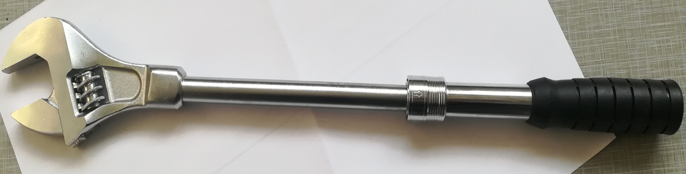
Extension adjustable wrench
WB-58B型活扳手（柄部可伸缩）
Size: 12’’
Design with extra wide opening
Open capacity 36mm
Total length 360mm—500mm
6 position for labor saving

Slide 10


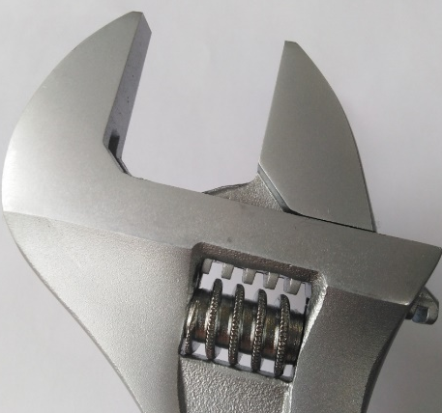
WB- 53Q Quick Jaw ADJ Wrench
NEW
Pull this button can instantly enlarge the open width
Size: 8’’ 10’’ 12’’
Drop forged with alloy steel
Torque to meet ANSI
Design with withdraw button
Wide open capacity: 8“-34mm；10“-38mm；12“-44mm；
Forbidden to sell to Korea,Janpan and Canada

Slide 11
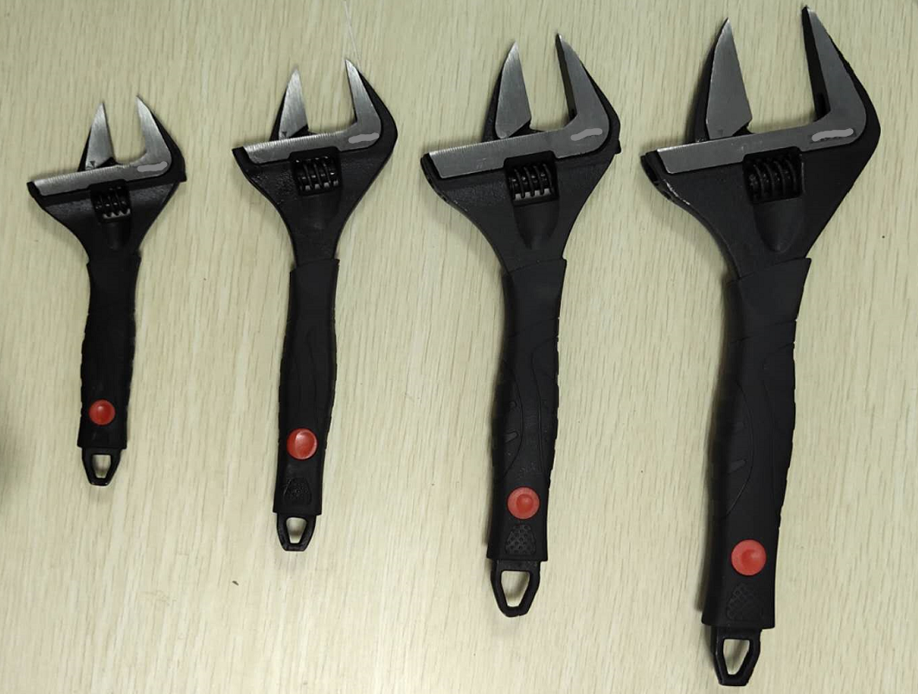
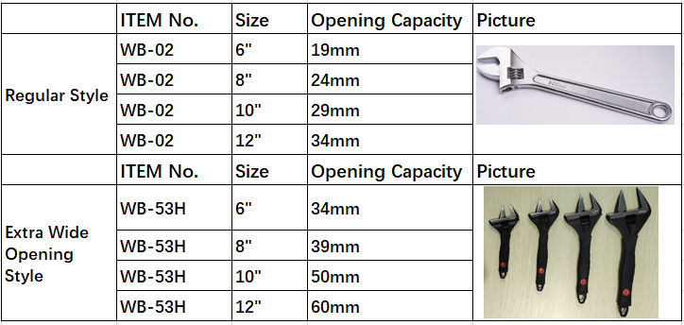
WB- 53H Extra wide opening capacity adjuatable wrench
ADJUSTABLE WRENCH
Size: 6’’ 8’’ 10’’ 12’’
Design with extra wide opening
6“-34mm
8“-39mm
10“-50m
12“-60mm
Forbidden to sell to UK,Poland

Slide 12
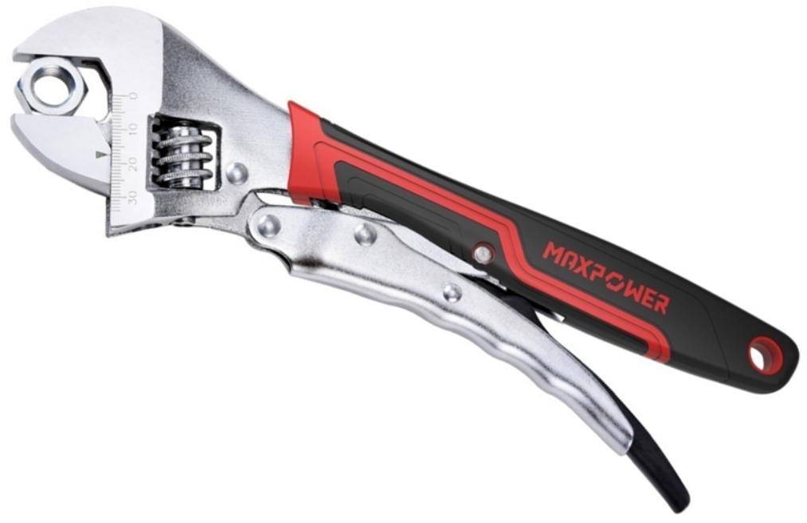
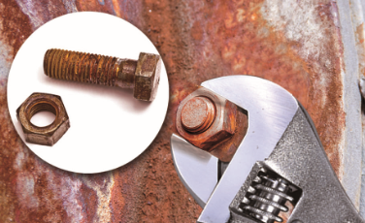
Locking Adjustable Wrench
NEW PRODUCTION
Size: only 10” is available,8”will be
developed soon.
Torque meet ANSI
Open capability : 30mm; Body length: 254mm
Special handle design strength the locking force
Convenient to remove rusted or tight bolts and nuts
With Comfortable Grip Handle
Forbidden to sell to Korea

Slide 13
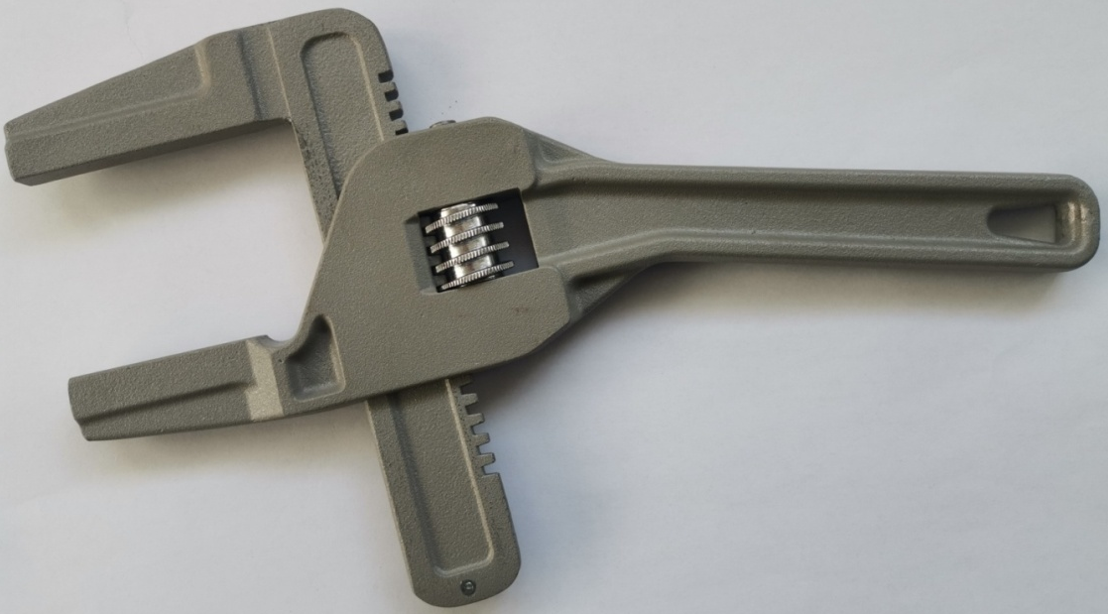
New design adjustable wrench
PATENTED
ITEM NO:WB- 56E
Size: 10’’
10” Body length: 260mm
Opening Capacity: 12-95mm
Aluminium body for light weight

Slide 14
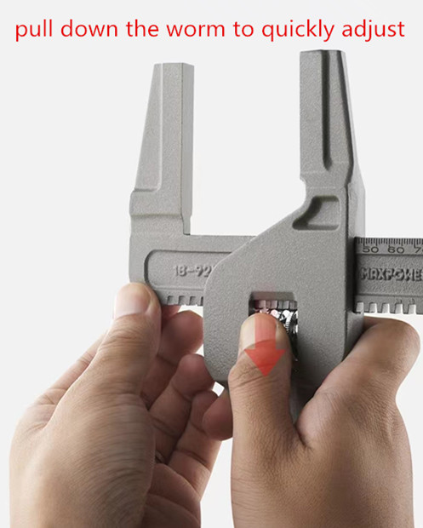
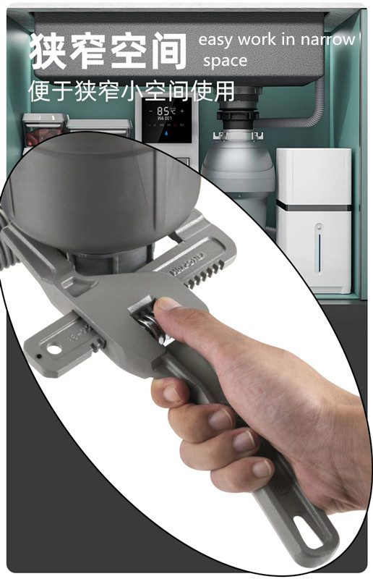
New design adjustable wrench

Slide 15
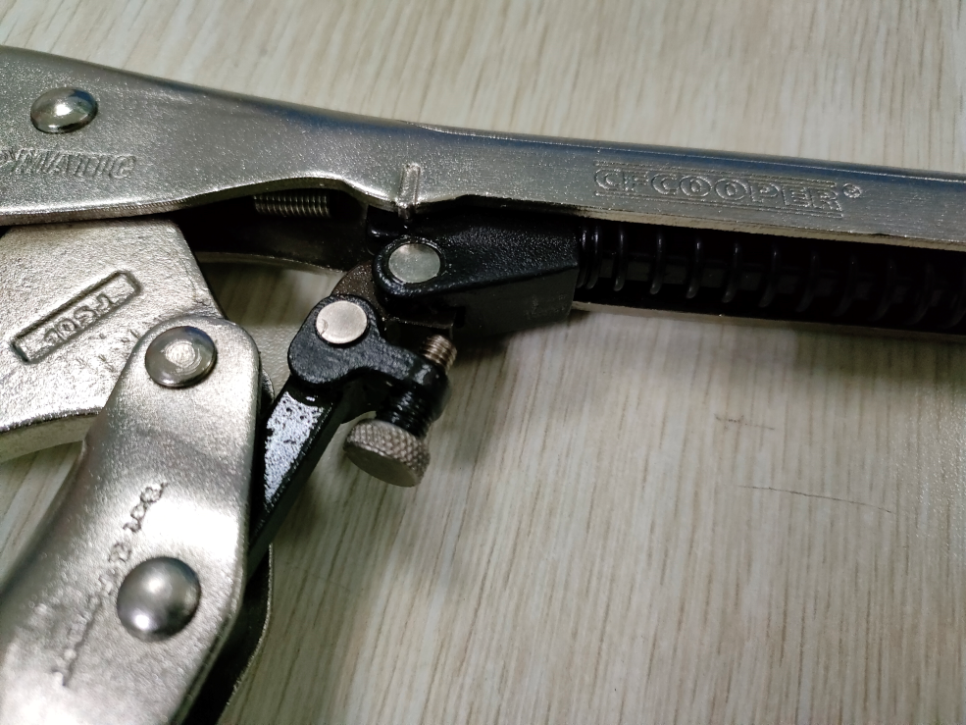
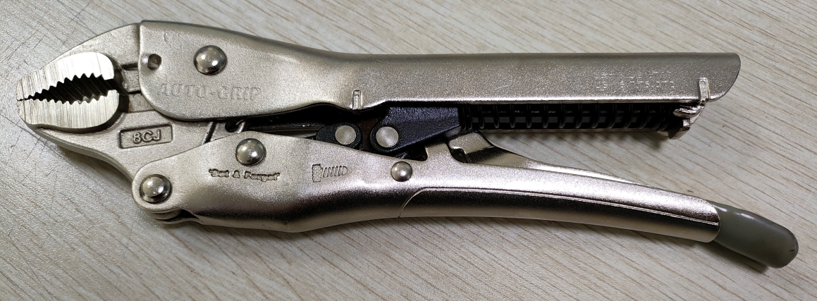
Locking Pliers
Foldable bolt cutter
Automatic Locking Pliers
Three kinds:Straight Jaw/Long Nose/Curved Jaw
Two rivet connection and grip spring design,makes opening more smoothly
The product can clamp different sizes because of the rivets
Spring design,which is more convenient than using grip screw
New use method:out pushing,is different from regular pilers
push this way opening

Slide 16
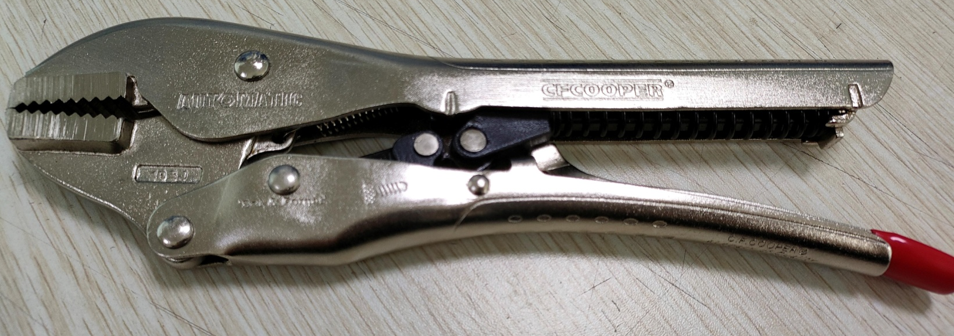
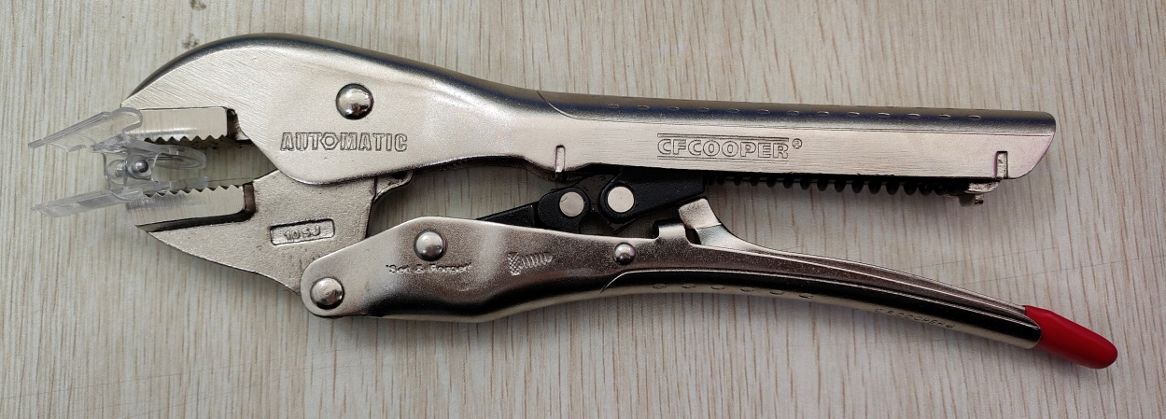
1.Straight Jaw Locking Pliers
Foldable bolt cutter
SIZE:8”,10”
Drop forged CRV steel jaws,good toughness
The clamping performance exceeds ANSI stanard,can clamp prism objects
Logo position(forging, Lasering)

Slide 17
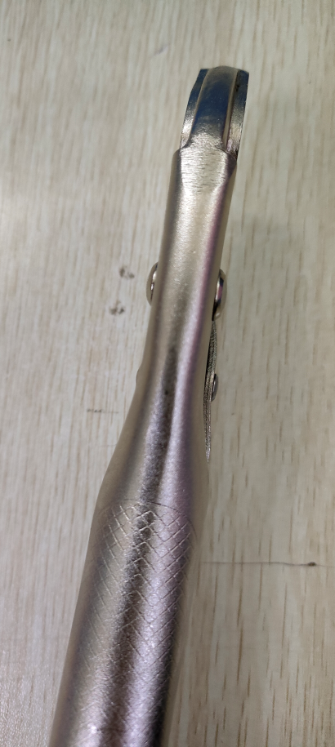
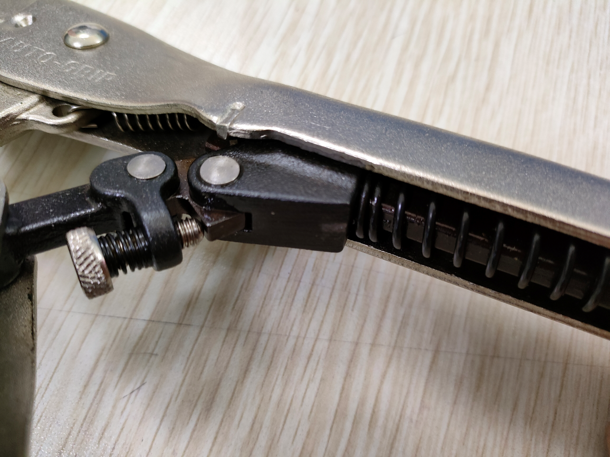
1.Straight Jaw Locking Pliers
Foldable bolt cutter
Ergonomic bi-material Anti-slip grips provide greater control and comfort in clamping
Two rivets make locking pliers more smoothly
Tighten by adjusting this screw

Slide 18
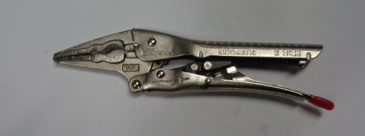
2.Long Nose Locking Pliers
Foldable bolt cutter
SIZE:7”
Long nose design suitable for narrow space
Drop forged CRV steel jaws,good toughness
Punched steel plate handle,heat treated,make the jaw harder
The clamping performance exceeds ANSI stanard,can clamp prism objects

Slide 19

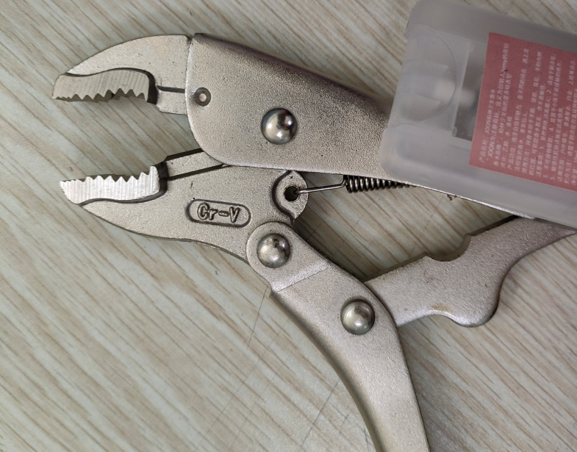
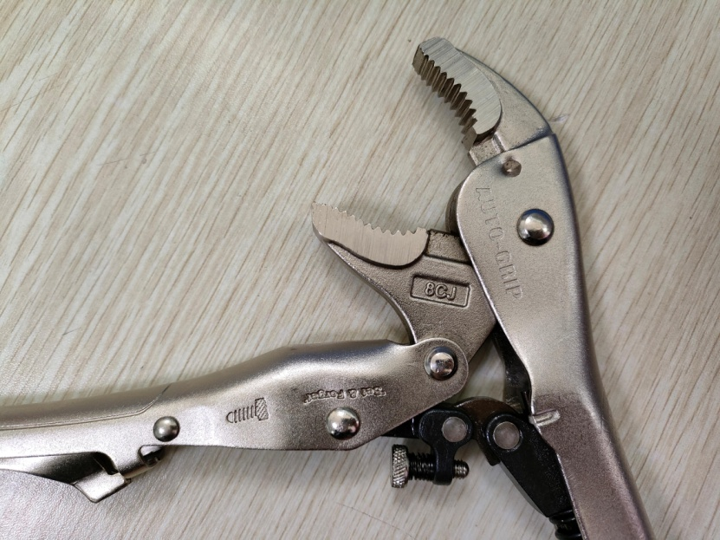
3.Curved Jaw Locking Pliers
Foldable bolt cutter
SIZE:6”,8”,10”
Drop forged CRV steel jaws,good toughness
The clamping performance exceeds ANSI stanard,can clamp prism objects
If compare with other pliers:
Regular Locking Pliers
Wider jaws opening

Slide 20
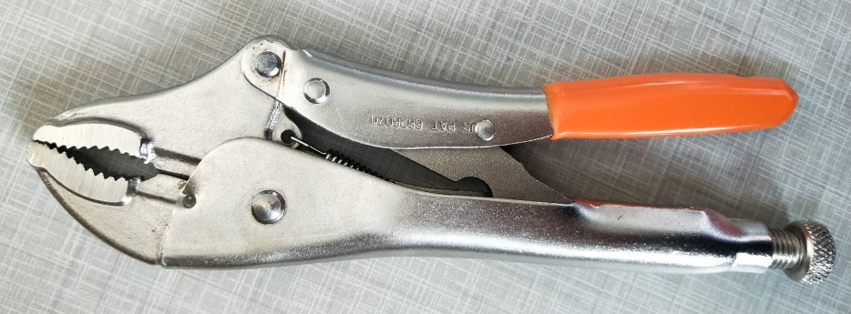
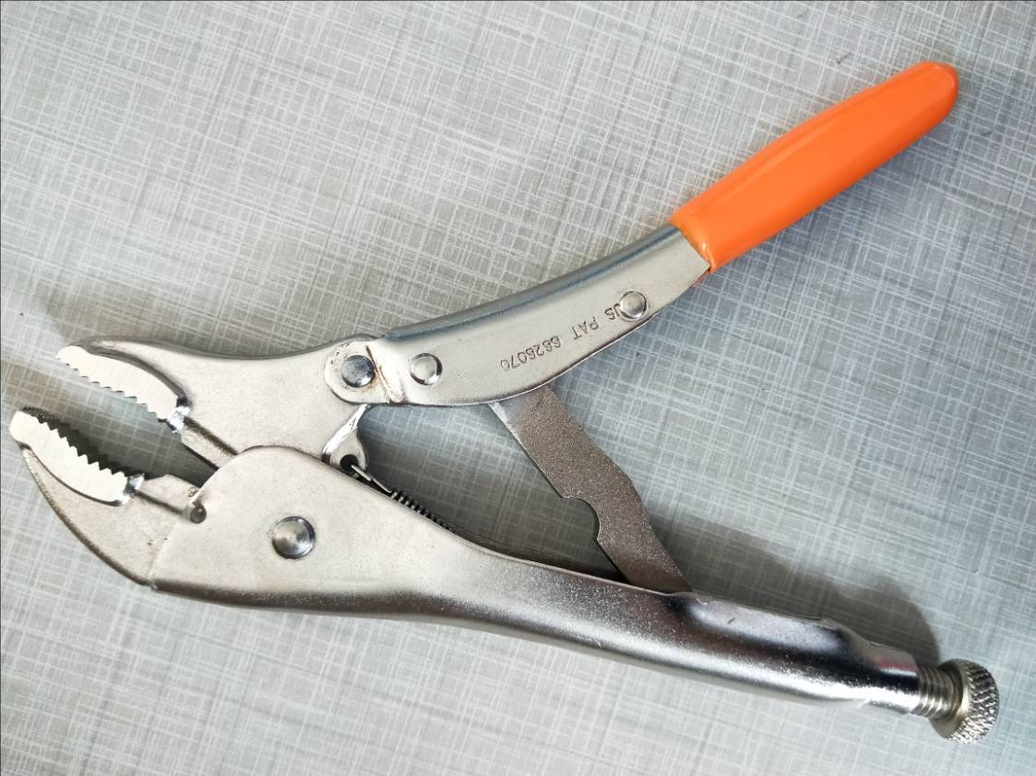
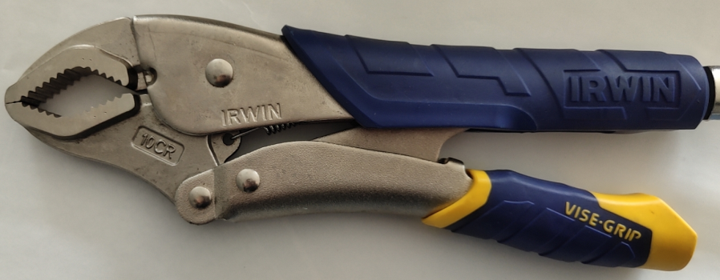
DL-50 Fast Release Locking Pliers
Locking Pliers
Size :10”
With special design of the release handle
Cr-V material jaws
Fast release function
Relese the handle by one hand,easy to operate
Opening Capacity:47.8mm
Similar function to Vice Grip

Slide 21
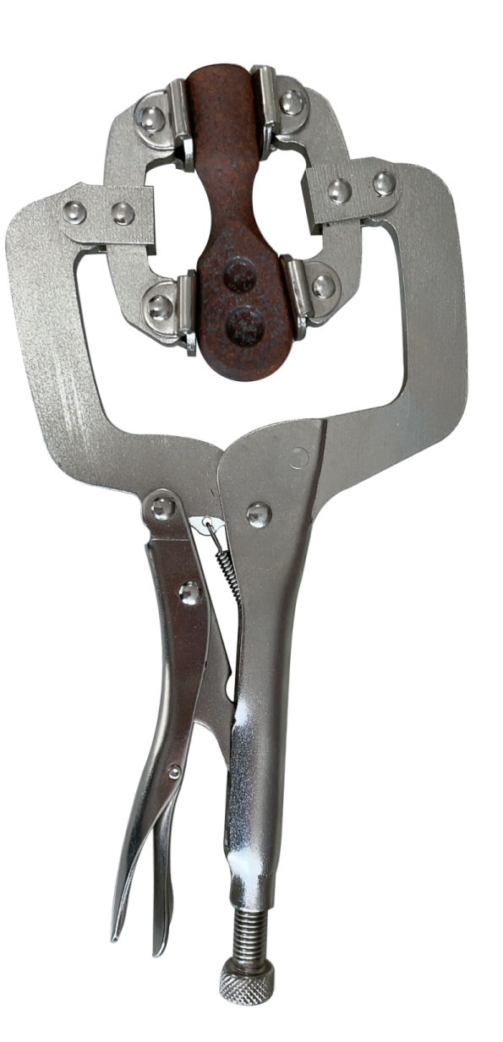
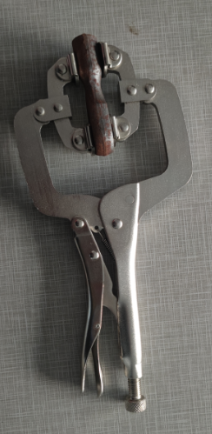
Multifunction C Locking Pliers
Size:11”
Material quality：
Point of innovation：On the basis of C-type pliers, the number of head pressure feet is increased, and the design of four pressure feet increases the type of clamping workpiece.
Application scenarios：This type of plier can firmly grip parts with uneven thickness and uneven surface
Materials：Carbon steel

Slide 22
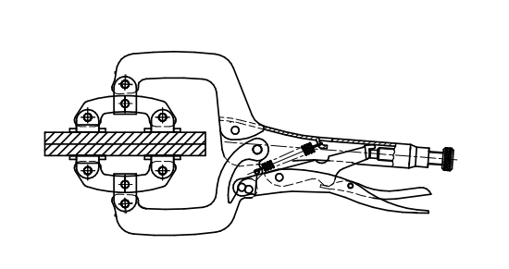
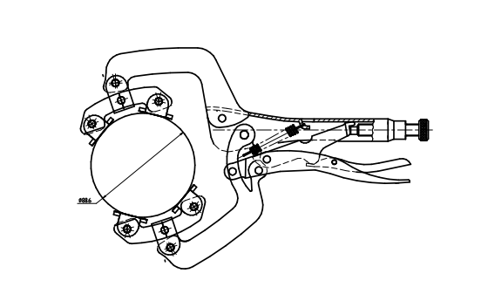
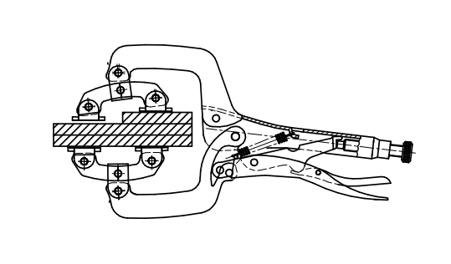
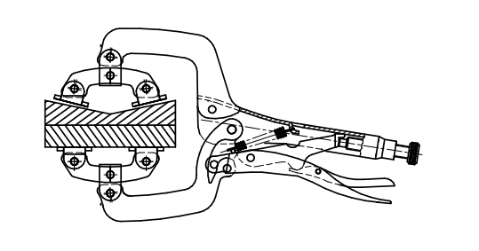
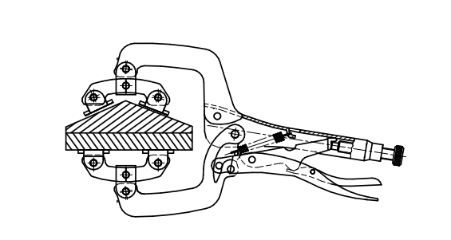
Multifunction C Locking Pliers
Schematic illustration of gripping an irregular object

Slide 23
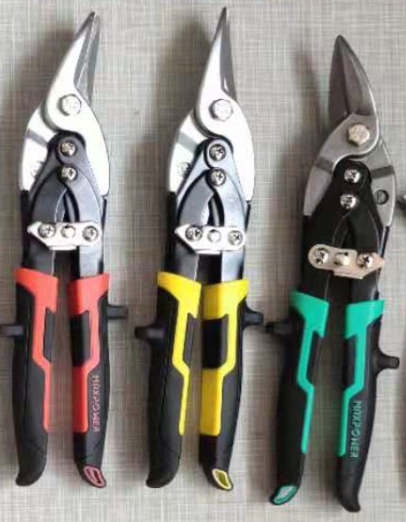
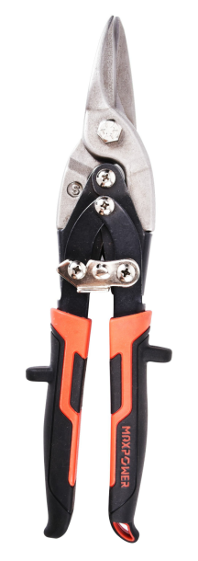
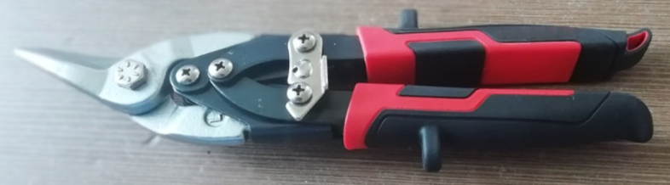
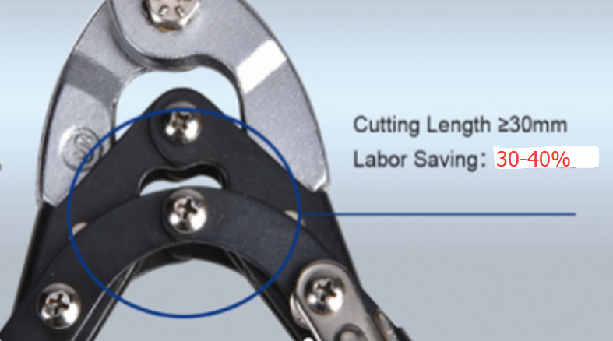
JT-20 Labor Saving Aviation Snip
Size:10”
Patent Product
Body hardness: 46-52 HRC
Blade hardness:56-62HRC
Type: Left/Straight/Right
Cutting Length >= 30mm
labor-saving is 30%~40% than standard
Double-color Comfort Handle
Use double lever principle to achieve the goal of labor saving

Slide 24
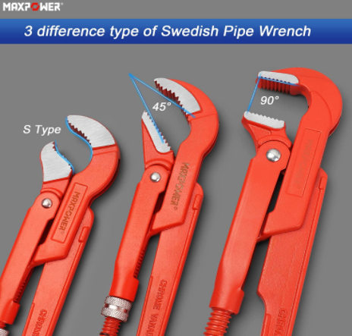
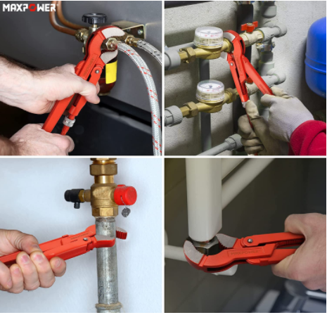
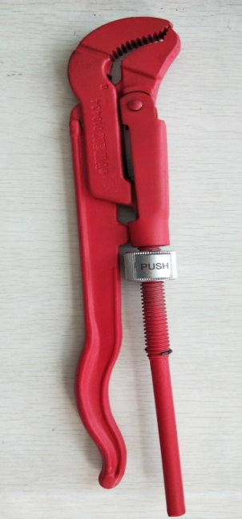
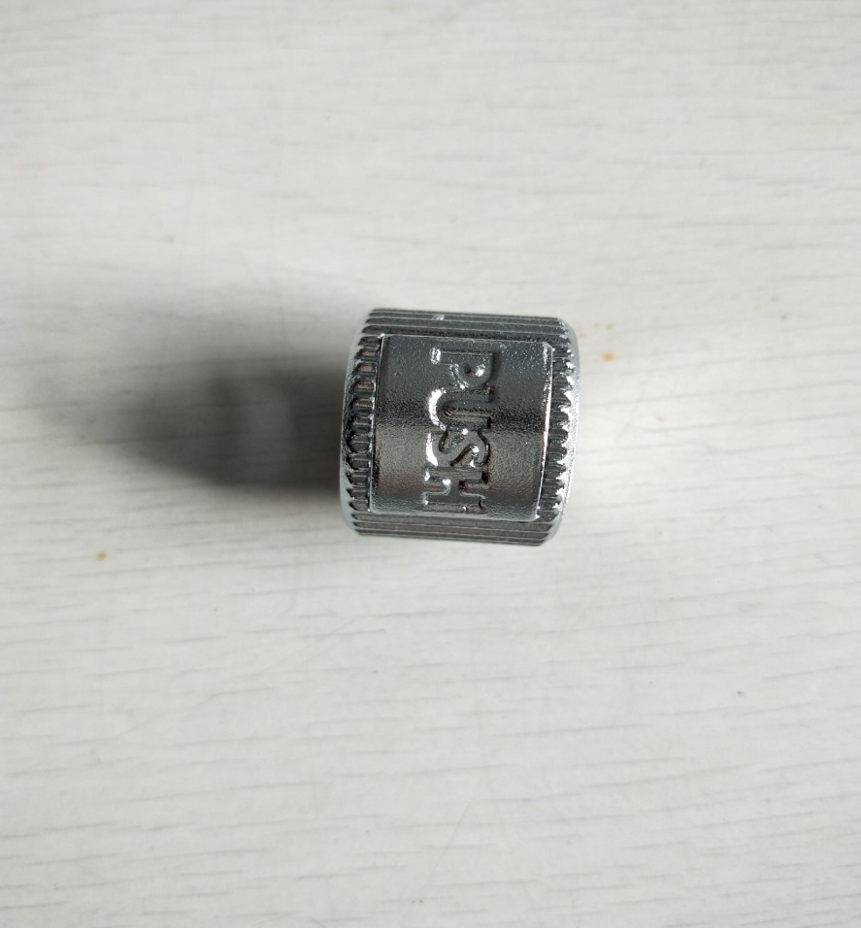
Quick adjust Swedish pipe wrench
Swedish style pipe wrench provide a firmly grip and plenty of leverage, slim head design for easily adjustment in tight spaces
Knurled steel adjustment nut fast adjustment, to lock onto a variety of positions, Safety stop prevents threading-of
Special design for quick release nut

